Slide 1
Real time challan Creation and management system
Theme:
Smart Transportation and
Traffic Management
Team Name: The Untitled
Team Number: 72
Unique Id : STTM41
College: Delhi Technological University
Branch: Computer Engineering
Vasu Gupta(Team Leader)
Utkarsh Tyagi
Aneesh Kundu
Pranay Rawat
Bhanu Pratap Raghav

Slide 2
Problem of Present challan system
SOURCE: INDIA TODAY
https://www.indiatoday.in/india/story/agra-registers-5-lakh-traffic-violations-everyday-1419584-2018-12-29

Slide 3
Current IMPLEMENTED BY GOVT(features)
ALLERTS THE OFFICILAS AT THE TOLL PLAZA ABOUT SPEED VIOLATIONS. THE VIOLATORS WILL BE ISSUED CHALLANS ONCE HE/SHE REACHES TOLL PLAZA.
THE NUMBER OF TRAFFIC POLICEMEN WILL BE INCREASED FROM 2 TO 7 WHO MANUALLY UPDATE CHALLANS.
CAMERAS ARE INSTALLED AT TWO POINTS –(SECTOR 57 AND 31 ,NOIDA). THE CAMERAS CAPTURE THE VIOLATORS AND CHALLANS ARE ISSUED IN THEIR MAILING ADDRESSES.

Slide 4
Discrepancies IN CURRENT MODEL
CHALLANS ISSUED ON TOLL PLAZA ONLY => NEED SOMETHING FAST
INCREASING WORKFORCE AND REGISTERING CHALLANS MANUALLY THROUGH APP => NEED SOMETHING SIMPLER/CONCISE .
THE CHALLANS ARE SENT TO THE MAILLING ADDRESS => LESS LABOUR AND TIME SAVING SYSTEM REQUIRED.

Slide 5
Why our model is a Show Stopper
MODEL IS REAL-TIME
MODEL CAN BE RUN AUTOMATICALLY, NO NEED OF HUMAN INTERVENTION
THE MAIL IS RECEIVED WITHIN SECONDS ALONG WITH TEXT MESSAGE
NO NEED TO CAPTURE IMAGES MANUALLY AS IN CASE OF AGRA IMPLEMENTATION
EVIDENCE OF VIOLATION IS PROVIDED AT THE LOGIN PORTAL
LOCATION OF CHALLAN CREATION IS PROVIDED IN MAP
SAVES DELIEVERY TIME AND MANAGEMENT COST
NO CHANCES OF BRIBERY
ONLINE PORTAL FOR PAYING CHALLANS
LICENSE NUMBER IS ABORTED AFTER FIXED NUMBER OF CHALLANS

Slide 6
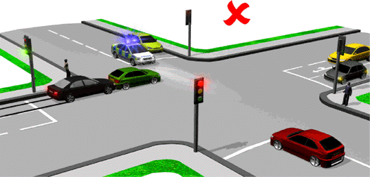
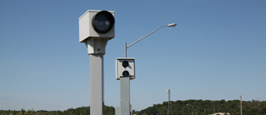
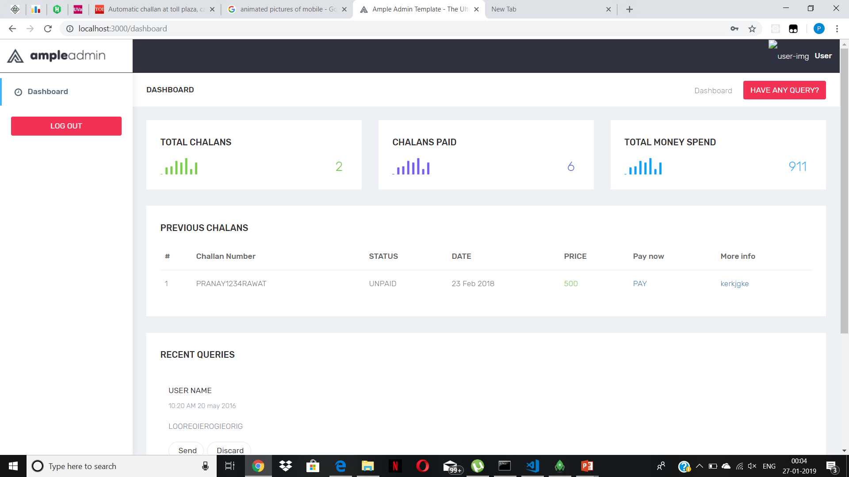
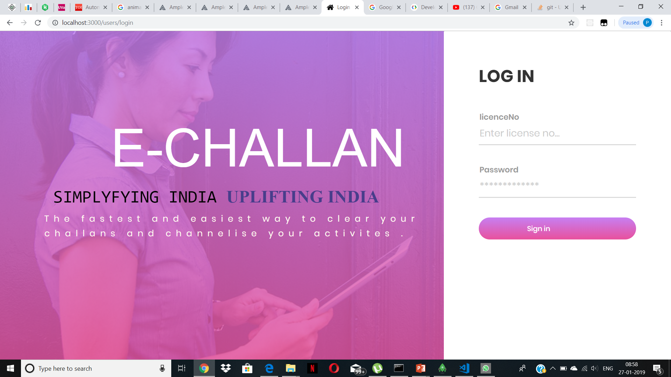
WORKFLOW OF OUR MODEL

Slide 7
Its time for you to experience the drill
OUR TEAM MEMBERS WILL NOW GIVE YOU A QUICK OVERVIEW OF MODEL

Slide 8
FUTURE SCOPE OF OUR MODEL
TRACKING OF STOLEN CARS.
ALL TYPE OF TRAFFIC VIOLATIONS CAN BE MONITORED LIKE OVERSPEEDING.
CAMERAS LIKE KINECT SENSOR CAN BE USED FOR BROADENING THE ASPECT OF OUR MODEL
REAL TIME TRAFFIC FLOW CAN BE MONITORED

Slide 9
TECHNOLOGY STACK
FRONTEND – HTML5, EJS, CSS3, MATERIALIZE
BACKEND – NODE.JS, EXPRESS
DATABASE – MONGODB
PAYMENT API – PAYU MONEY
MACHINE LEARNING – SUPPORT VECTOR MACHINE AND CLASSIFIER
COMPUTER VISION – OPENCV, SKIMAGE

Slide 10
Thank you

